Slide 1
JavaCups
CritiqueCafe
Enmanuel Ortiz: Github master/Back-end dev
Sadiki Brown: Front-end dev
Teri-Ann Barber: Scrum Master/Back-end dev
Richard Santiago: Front-end dev
http://lamp.cse.fau.edu/~eortiz2018/Minibb/
http://www.free-powerpoint-templates-design.com

Slide 2
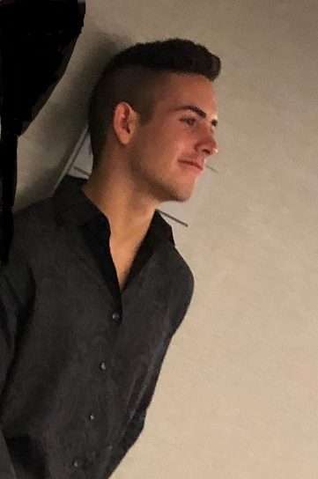
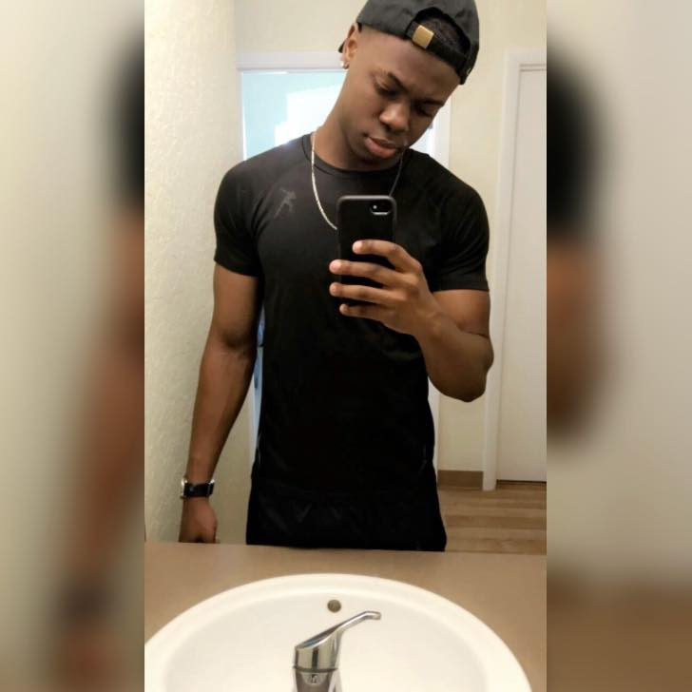
Front-end devs
Richard Santiago
Sadiki Brown
Front-end lead
Front-end back-up
Designed basic site structure, and helped develop it.
Helped design site structure and helped with documentation

Slide 3
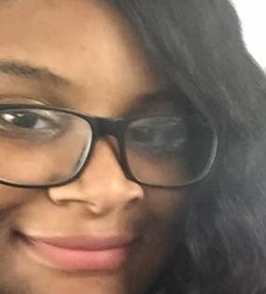
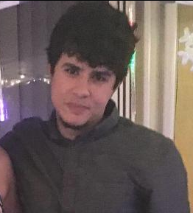
Back-end devs
Teri-Ann Barber
Enmanuel Ortiz
Scrum Master
Back-end dev, set team goals on trello and ensured they were being worked toward
Github Master
Back-end dev, worked on database functionality and php adjustment.

Slide 4
01
Purpose
To create a community that can discuss any type of media, ranging from books to games, movies to miscellaneous.
02
Motivation
This website was mostly created due to the massive use of imageboards/forums nowadays, these types of forums usually garner a huge following or large community support (e.g. Reddit, Stack overflow, etc.)
03
Functionalities
Search: Ability to find what you need quickly, search up any keyword needed for a specific review/opinion
User login/registration: Ability to login to your personalized account and post and reply to other people's opinions
Posting/Replying: Ability to post/reply, can post images, hyperlinks, or even YouTube videos
04
Target audience
End-users that want to review/discuss their opinion
End-users looking for reviews on a specific media

Slide 5
System implementation
Infrastructure
What languages were used? DB? Platform? Etc.

Slide 6
Infrastructure
Platform
Languages
Framework
Database
Google chrome
Opera
Internet explorer
Firefox
PHP
CSS
HTML
Scrum
MySQL
LAMP

Slide 7
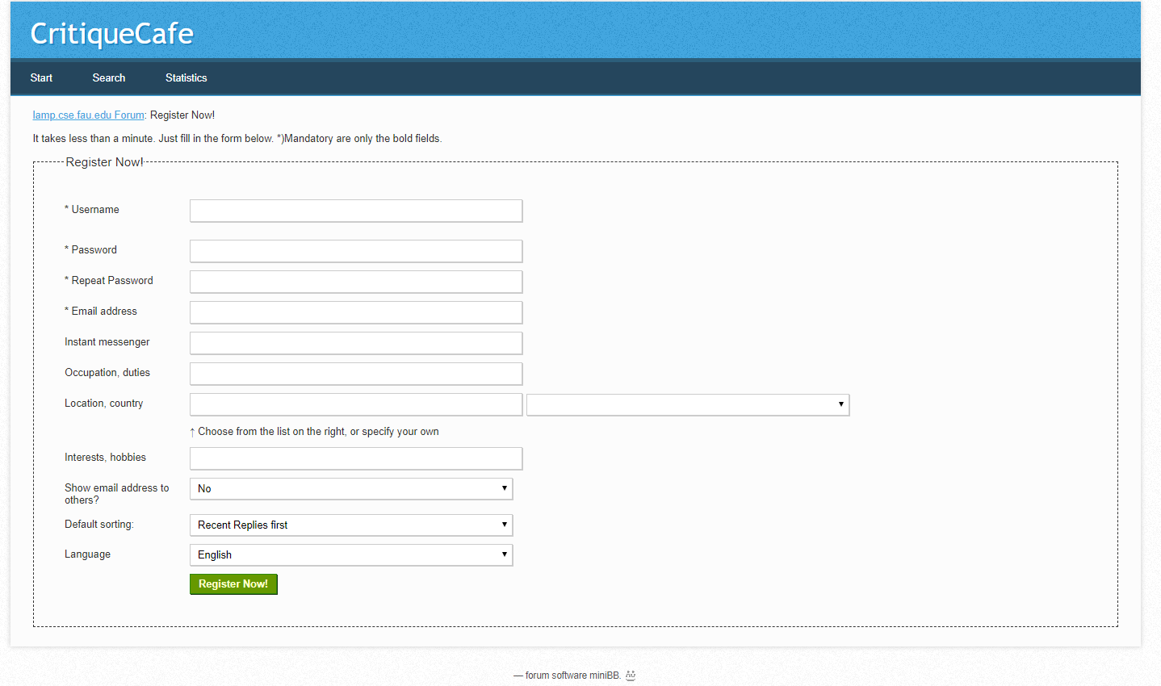
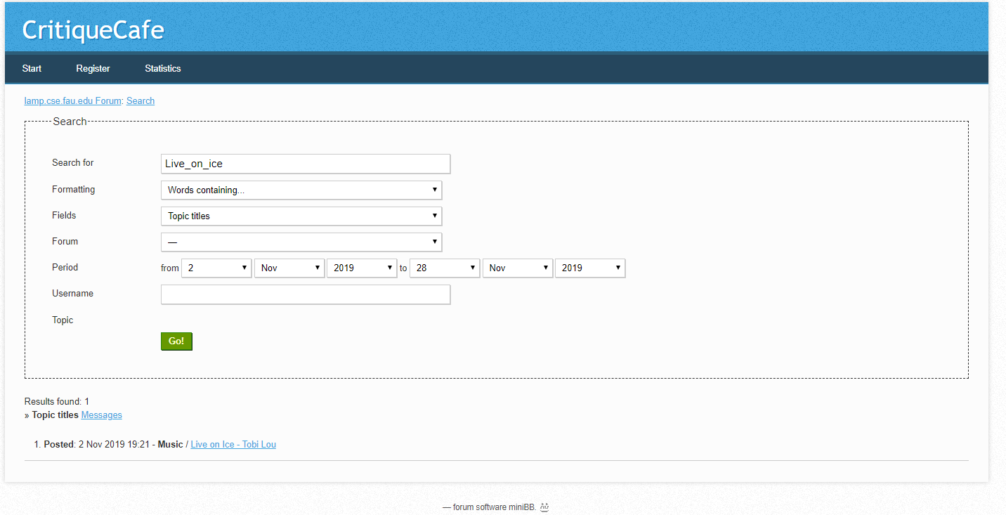
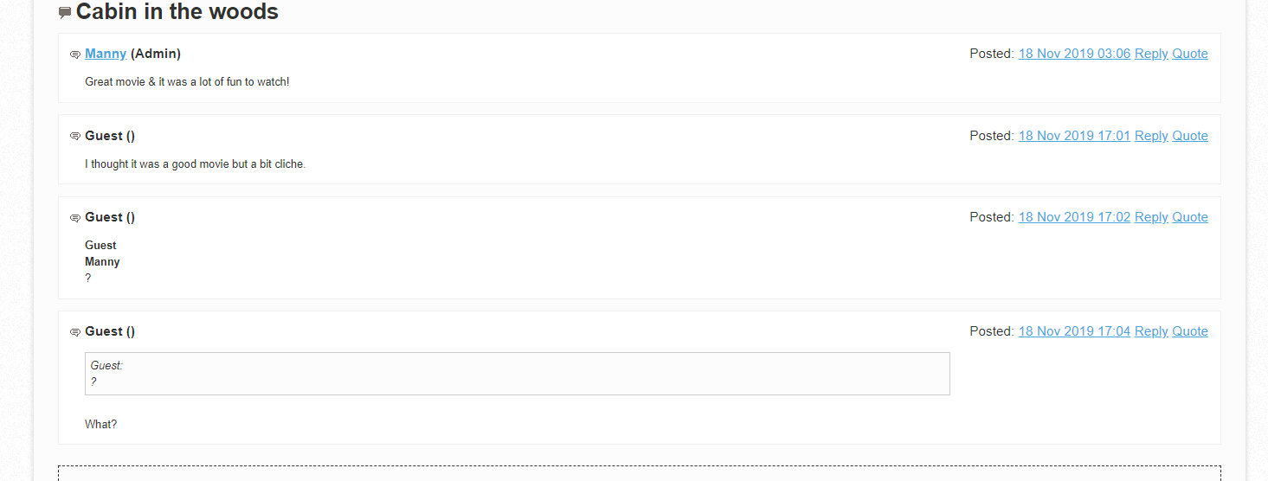
01
User registration/login
Saving the user information through a PHP file to an SQL server for quick access to their account. Allows them to be recognized by other posters/commenters.
02
Search functionality
Quick search through subject, should search through all subjects; Allows end-user to save time by finding his/her item immediately.
03
User post/reply
Ability to post images/videos to accompany replies/initial posts.

Slide 8


Non-functional Requirements
Availability
Ease of use
Downtime should be very minimal; website should be active for the whole day unless server is shut down for an unknown reason.
Quick access to all subjects given to the end-user; Easy and accessible for any skill level.
Immediate confirmation & Response time
Storage
Comments and replies should not take over a few seconds to process, no delay to posting an initial comment or replying to a comment. Site has super quick response time with any average internet connection.
Huge storage gives any user unrestricted number of posts.

Slide 9
Finished features
User profile
Adds more life to a profile, you can share hobbies or favorites with others who want to know more about you
YouTube API
YouTube API
Allows users to link a specific video in their initial post/reply to further drive their opinion, or to show others what they’ve found
User profile
Guest login
Guest login
No need to register an account, guest logins allows you to stay anonymous with an opinion or if you want to respond to a message quickly without having an account

Slide 10
Knowledge gained
What we learned
Overall this was a great experience, we gained the knowledge of how to deal with a website overall, especially one of such complexity. The whole base foundation we had will help us in the future if we look over it, it’s defined so much and helped us understand how to create/work a website. Also, Trello is a wonderful website to keep everything on track, which I’ve never heard about before, so it’s a nice addition to needed programs.
Experience with team communications
More knowledge and experience with languages, like PHP and CSS.
Learned programs like Trello and Balsamiq that can help the process of making a website.

Slide 11
Thank You
Hope you enjoyed this PowerPoint

